Slide 1
MODULE 1
INTRODUCTION TO CASTING PROCESS

Slide 2
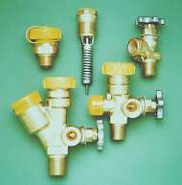
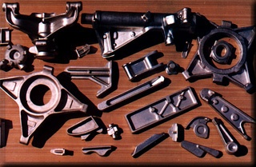
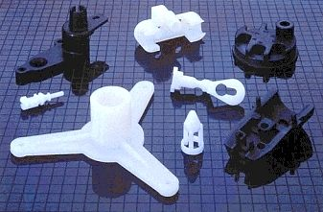
Manufacturing Process
“The Process of Converting Raw Materials Into Finished Products "or Shaping of raw materials into finished products
Cost
Material
Use

Slide 3
NEED & CONCEPT OF MANUFACTURING PROCESS
The progress and the prosperity of human civilization are governed and judged mainly by improvement and maintenance of standard of living through availability or production of ample and quality goods and services for men’s material welfare in all respects covering housing, clothing, medicine, education, transport, communication and also entertainment. The successful creation of men’s material welfare depends mainly on
• availability of natural resources (NR)
• exertion of human effort (HE); both physical and mental
• development and use of power tools and machines(Tools)
Production or manufacturing can be simply defined as value addition processes by which raw materials of low utility and value due to its inadequate material properties and poor or irregular size, shape and finish are converted into high utility and valued products with definite dimensions, forms and finish imparting some functional ability.

Slide 4
IMPORTANCE
Today’s competitive manufacturing era of high industrial development and research, is being called the age of mechanization, automation and computer integrated manufacturing
Due to new researches in the manufacturing field, the advancement has come to this extent that every different aspect of this technology has become a full-fledged fundamental and advanced study in itself.
This has led to introduction of optimized design and manufacturing of new products
New developments in manufacturing areas are deciding to transfer more skill to the machines for considerably reduction of manual labour.
The scope of the subject manufacturing process is extremely wide as it specifies the need of greater care for man, machine, material and other equipments involving higher initial investment by using proper safety rule and precautions. .

Slide 5
CLASSIFICATION OF MANUFACTURING PROCESS
Based on the property of metal
Casting, Welding( Fusibility)
Machining ( Divisibility)
Metal Forming( Ductility/ Malleability)
Non traditional Machining

Slide 6
CLASSIFICATION OF MANUFACTURING PROCESS
Based on metal removal
Cutting Process
Non Cutting process
Another mode of classification is
Primary process
Secondary process

Slide 7
PRODUCTION PROCESSES
Casting
Welding
Machining
Rolling
Forging
Extrusion
Wire drawing
Sheet metal working

Slide 8
INTRODUCTION
Metal casting involves pouring molten metal into a mould containing a cavity of the desired shape to produce a metal product. The casting is then removed from the mould and excess metal is removed, often using shot blasting, grinding or welding processes. The product may then undergo a range of processes such as heat treatment, polishing and surface coating or finishing.

Slide 9
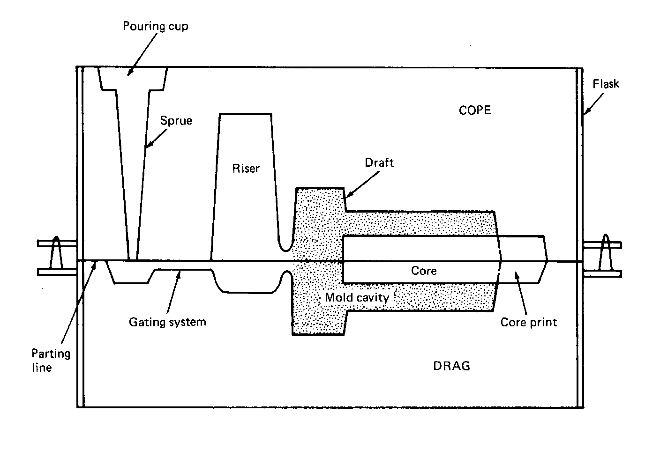
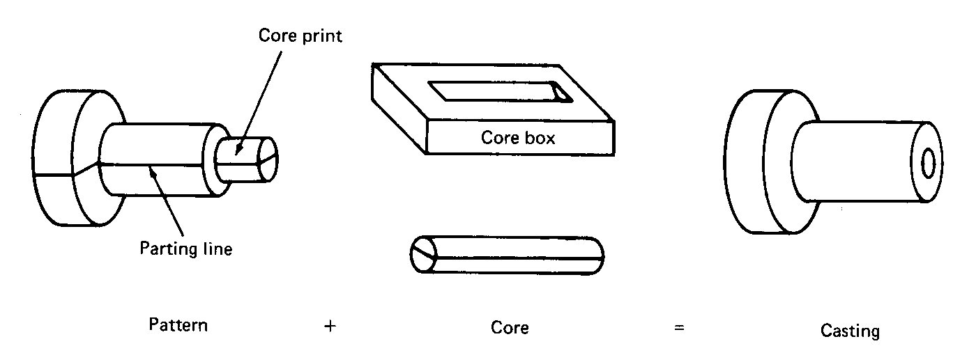
Sand Casting Terminology

Slide 10
STEPS INVOLVED IN CASTING

Slide 12
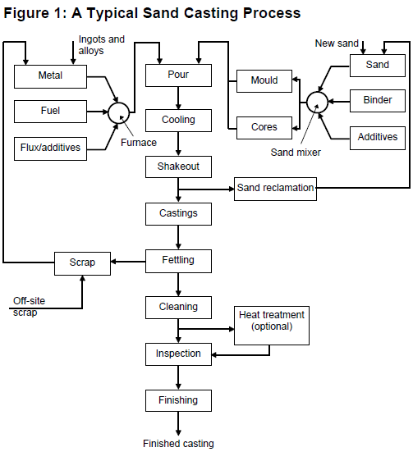
SAND CASTING PROCESS - FLOWCHART

Slide 13
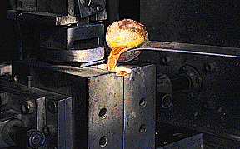
STEPS INVOLVED IN CASTING
Pattern making
Mould making
Melting & Pouring
Cooling & shakeout
Sand reclamation
Fettling, Cleaning & Inspection

Slide 14
PATTERN MAKING
Pattern making is the first stage for developing a new casting. The pattern, or replica of the finished piece, is typically constructed from wood but may also be made of metal, plastic, plaster or other suitable materials. These patterns are permanent so can be used to form a number of moulds. Pattern making is a highly skilled and precise process that is critical to the quality of the final product. Many modern pattern shops make use of computer-aided design (CAD) to design patterns. These systems can also be integrated with automated cutting tools that are controlled with computer-aided manufacturing (CAM) tools . Cores are produced in conjunction with the pattern to form the interior surfaces of the casting. These are produced in a core box, which is essentially a permanent mould that is developed

Slide 15
MOULD MAKING
The mould is formed in a mould box (flask), which is typically constructed in two halves to assist in removing the pattern. Sand moulds are temporary so a new mould must be formed for each individual casting.
The bottom half of the mould (the drag) is formed on a moulding board. Cores require greater strength to hold their form during pouring. Dimensional precision also needs to be greater because interior surfaces are more difficult to machine, making errors costly to fix. Cores are formed using one of the chemical binding systems . Once the core is inserted, the top half of the mould (the cope) is placed on top. The interface between the two mould halves is called a parting line. Weights may be placed on the cope to help secure the two halves together, particularly for metals that expand during cooling

Slide 16
MOULD MAKING
Mould designs include a gating system which is designed to carry molten metal smoothly to all parts of the mould. The gating system typically includes a sprue, gates, runners and risers. The sprue is where the metal is poured. Gates allow the metal to enter the running system. Runners carry the molten metal towards the casting cavity. Risers may have several functions including vents to allow gases to be released, reservoirs prior to the casting cavity to aid progressive solidification, and waste cavities to allow metal to rise from the casting cavity to ensure it is filled and to remove the first poured metal from the casting cavity, thus avoiding solidification problems

Slide 17
MELTING & POURING
Many foundries, particularly ferrous foundries, use a high proportion of scrap metal to make up a charge. As such, foundries play an important role in the metal recycling industry. Internally generated scrap from runners and risers, as well as reject product, is also recycled. The charge is weighed and introduced to the furnace. Alloys and other materials are added to the charge to produce the desired melt. In some operations the charge may be preheated, often using waste heat.. In traditional processes metal is superheated in the furnace. Molten metal is transferred from the furnace to a ladle and held until it reaches the desired pouring temperature. The molten metal is poured into the mould and allowed to solidify

Slide 18
Cooling and Shakeout
Once the metal has been poured, the mould is transported to a cooling area. The casting needs to cool, often overnight for ambient cooling, before it can be removed from the mould. Castings may be removed manually or using vibratory tables that shake the refractory material away from the casting. Quenching baths are also used in some foundries to achieve rapid cooling of castings. This speeds up the process and also helps achieve certain metallurgical properties. The quench bath may contain chemical additives to prevent oxidation.

Slide 19
Sand Reclamation
Most sand foundries recover a significant proportion of the waste sand for internal reuse. This significantly reduces the quantity of sand that must be purchased and disposed of. Most sand is reclaimed mechanically; cores and large metal lumps are removed by vibrating screens and the binders are removed by attrition (i.e. by the sand particles rubbing together). Fine sand and binders are removed by extraction and collected in a bag house. In some systems metals are removed using magnets or other separation techniques.

Slide 20
Fettling, Cleaning and Finishing
After the casting has cooled, the gating system is removed, often using band saws, abrasive cut-off wheels or electrical cut-off devices. A ‘parting line flash’ is typically formed on the casting and must be removed by grinding or with chipping hammers. Castings may also need to be repaired by welding, brazing or soldering to eliminate defects.
The casting may undergo additional grinding and polishing to achieve the desired surface quality. The casting may then be coated using either a paint or a metal finishing operation such as galvanising, powder coating

Slide 21
Advantages of Sand Casting
Use is widespread; technology well developed.
Materials are inexpensive, capable of holding detail and resist deformation when heated.
Process is suitable for both ferrous and non-ferrous metal castings.
Handles a more diverse range of products than any other casting method.
Produces both small precision castings and large castings of up to 1 tonne.
Can achieve very close tolerances if uniform compaction is achieved. Mould preparation time is relatively short in comparison to many other processes.
The relative simplicity of the process makes it ideally suited to mechanisation.
High levels of sand reuse are achievable

Slide 22
Limitations
Typically limited to one or a small number of moulds per box..
Sand: metal ratio is relatively high.
High level of waste is generated
Applications
Turbine vanes, Power Generators, Railways, Agricultural Components, Construction equipments.

Slide 23
PATTERN
The pattern is the principal tool during the casting process. It is the replica of the object to be made by the casting process, with some modifications. The main modifications are the addition of pattern allowances, and the provision of core prints. If the casting is to be hollow, additional patterns called cores are used to create these cavities in the finished product. The quality of the casting produced depends upon the material of the pattern, its design, and construction. The costs of the pattern and the related equipment are reflected in the cost of the casting.

Slide 24
Functions of the Pattern
1. A pattern prepares a mold cavity for the purpose of making a casting.
2. A pattern may contain projections known as core prints if the casting requires a core and need to be made hollow.
3. Runner, gates, and risers used for feeding molten metal in the mold cavity may form a part of the pattern.
4. Patterns properly made and having finished and smooth surfaces reduce casting defects.
5. A properly constructed pattern minimizes the overall cost of the castings.

Slide 25
Pattern Material
Patterns may be constructed from variety of materials. Each material has its own advantages,
limitations, and field of application. Some materials used for making patterns are: wood,
metals and alloys, plastic, plaster of Paris, plastic and rubbers, wax, and resins. To be
suitable for use, the pattern material should be:
1. Easily worked, shaped and joined
2. Light in weight
3. Strong, hard and durable
4. Resistant to wear and abrasion
5. Resistant to corrosion, and to chemical reactions
6. Dimensionally stable and unaffected by variations in temperature and humidity
7. Available at low cost
The usual pattern materials are wood, metal, and plastics. The most commonly used pattern material is wood, since it is readily available and of low weight. Also, it can be easily shaped and is relatively cheap.
The main disadvantage of wood is its absorption of moisture, which can cause distortion and dimensional changes.
Araldite is the new material for pattern making, which is referring to a range of engineering and structural epoxy, acrylic, and polyurethane adhesives

Slide 26
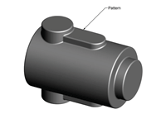
Types of Pattern
Solid pattern - A solid pattern is a model of the part as a single piece. It is the easiest to fabricate, but can cause some difficulties in making the mold. The parting line and runner system must be determined separately. Solid patterns are typically used for geometrically simple parts that are produced in low quantities.

Slide 27
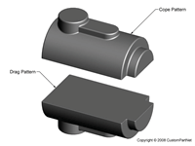
Split pattern
Split pattern models the part as two separate pieces that meet along the parting line of the mold. Using two separate pieces allows the mold cavities in the cope and drag to be made separately and the parting line is already determined. Split patterns are typically used for parts that are geometrically complex and are produced in moderate quantities.

Slide 28
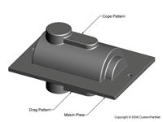
Match plate pattern
A match-plate pattern is similar to a split pattern, except that each half of the pattern is attached to opposite sides of a single plate. The plate is usually made from wood or metal. This pattern design ensures proper alignment of the mold cavities in the cope and drag and the runner system can be included on the match plate. Match-plate patterns are used for larger production quantities and are often used when the process is automated.

Slide 29
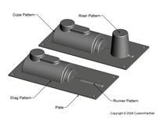
Cope and drag pattern
A cope and drag pattern is similar to a match plate pattern, except that each half of the pattern is attached to a separate plate and the mold halves are made independently. Just as with a match plate pattern, the plates ensure proper alignment of the mold cavities in the cope and drag and the runner system can be included on the plates. Cope and drag patterns are often desirable for larger castings

Slide 30
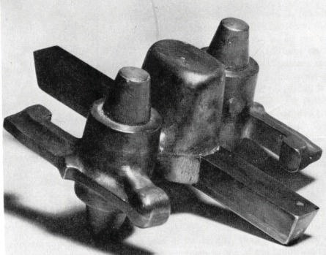
Gated Patterns
A gated pattern is a loose pattern that has the gating system included as a part of the pattern. This eliminates the time and inconsistency associated with hand-cutting the gates and runners. Also, since the gating system is designed and fabricated as part of the pattern, the consistency of molten metal flow into the casting and feeding of the casting during solidification is improved. Gated patterns are appropriate for pouring small quantities of castings when quick turn around and low cost are important.

Slide 31
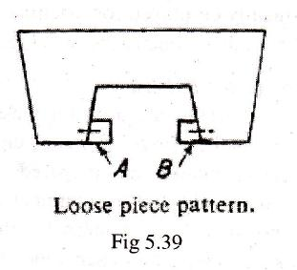
Loose-piece pattern
Patterns with complicated shapes which cannot be withdrawn easily. Loose pieces remains attached with the main body by using dowel pins. Requires more time for moulding operation and more labour

Slide 32
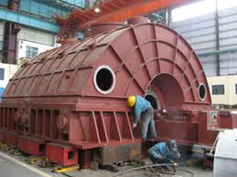
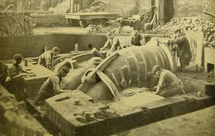
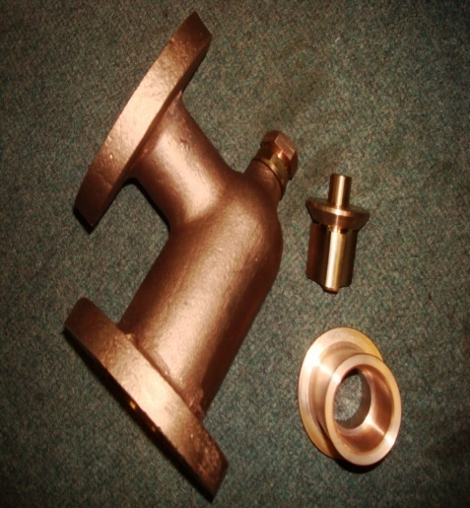
Skeleton patterns
When the size of the casting is very large, but easy to shape and only a few numbers are to be made, it is uneconomical to make a large solid pattern of that size. In such cases, a pattern consisting of wooden frame and strips is made called skeleton pattern. It is filled with loam sand and rammed. The core can be prepared separately either with the help of a core box or another skeleton made for that, and assembled in position in the mould.

Slide 33
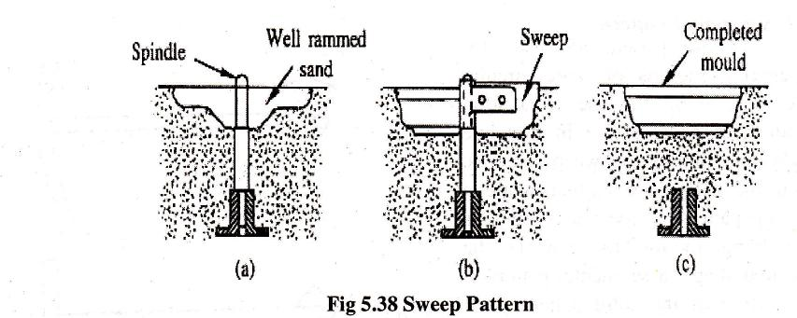
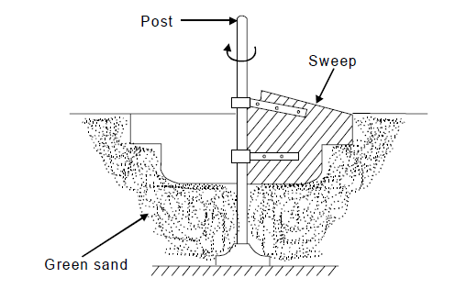
Sweep pattern
Sweeps can be advantageously used for preparing moulds of large symmetrical castings, particularly of circular cross section. This effect a large saving in time, labour and material. The full equipment consists of a base, suitably placed in the sand mass, a vertical spindle and a wooden template called sweep. The outer end of sweep carries the contour corresponding to the shape of the desired casting. The sweep is rotated about the spindle to form the cavity. Then the sweep and the spindle are removed, leaving the base in the sand. The hole made by the removal of spindle is patched up by filling the sand.

Slide 34
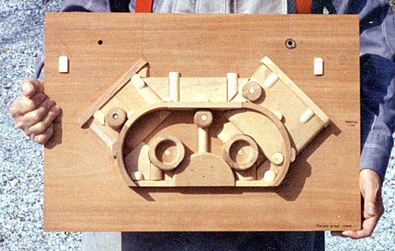
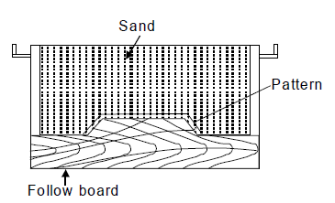
Follow board pattern
A follow board is a wooden board used to support a pattern during moulding. It acts as a seat for the pattern. Such single piece patterns which have an odd shape or very thin wall require a follow board.

Slide 35
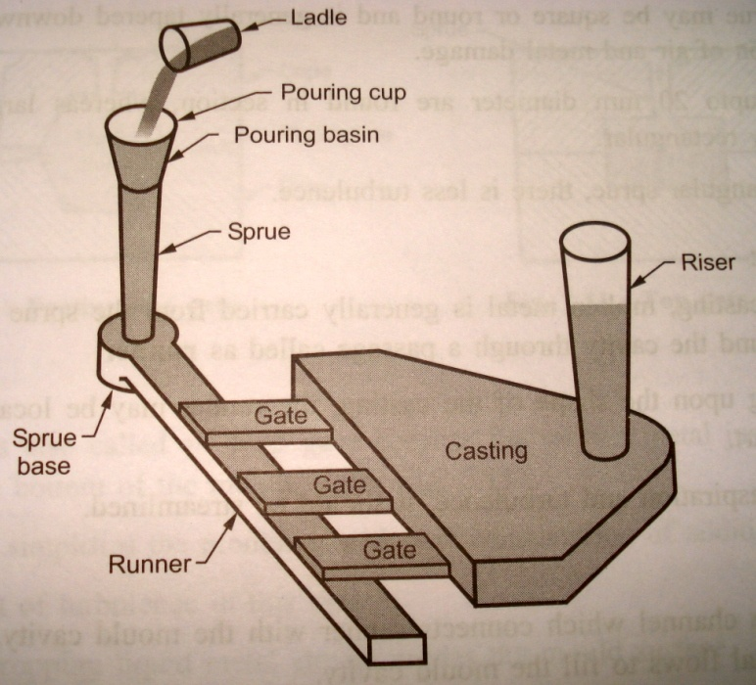
Concept of Gating and Risers

Slide 36
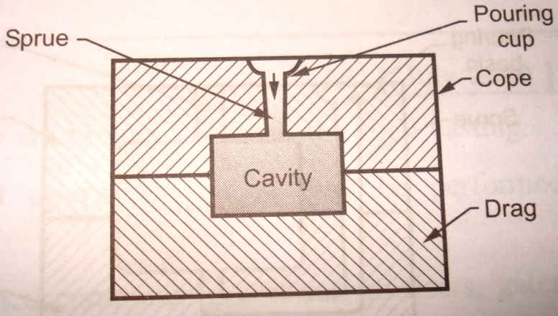
Top Gate are usually limited to relatively small castings of simple design. The turbulence of metal as it enters the mould cavity causes erosion, which is a major problem in the manufacture of steel castings. As such, top gate is gates used in steel foundries only for broad shapes of low heights.

Slide 37
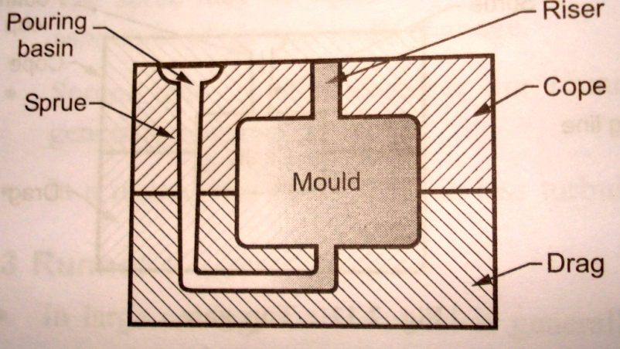
BOTTOM GATE:- Provided in drag half of the mould Liquid fills the bottom portion of mould and then rises up the mould walls Less Turbulence and erosion Used in large and deep castings because metal cools gradually as it rises up

Slide 38
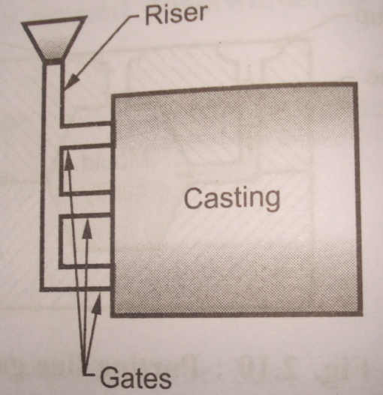
Side Gate:- Provided either on left or right of the casting, hence material enters from the sides into the mould cavity Enters from the bottom gate and then rises

Slide 39
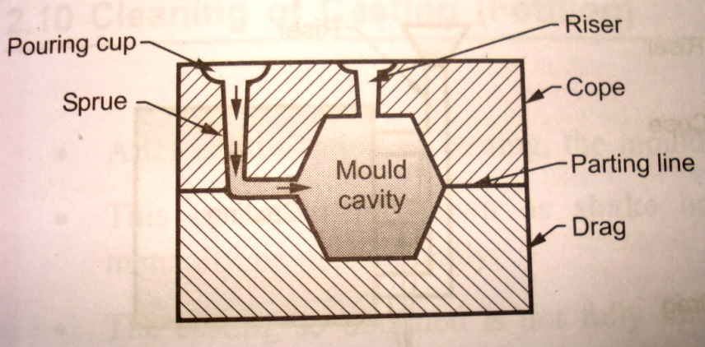
Parting line gate:- Molten metal enters along the parting line into the mould Simple and easy in construction

Slide 40
Casting Defects
Types
1. Gas Porosity: Blowholes, open holes, pinholes 2. Shrinkage defects: shrinkage cavity 3. Mold material defects: Cut and washes, swell, drops, metal penetration, rat tail 4. Pouring metal defects: Cold shut, misrun, slag inclusion 5. Metallurgical defects: Hot tears, hot spot

Slide 41
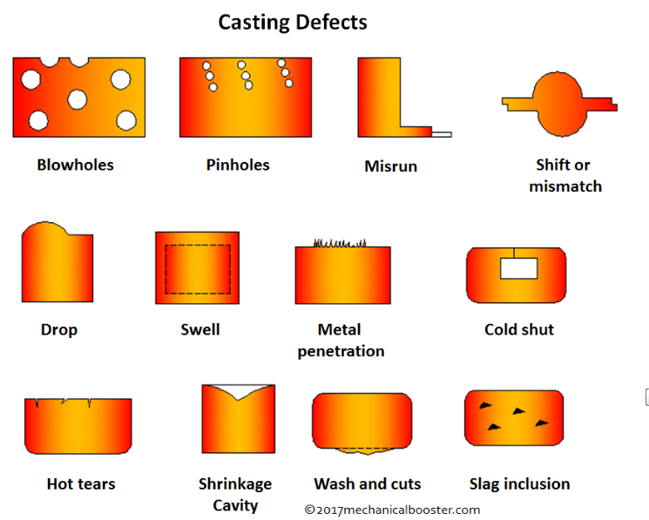

Slide 42
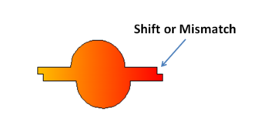
Shift or Mismatch
The defect caused due to misalignment of upper and lower part of the casting and misplacement of the core at parting line

Slide 43
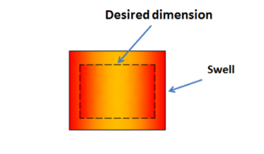
Swell
It is the enlargement of the mold cavity because of the molten metal pressure, which results in localised or overall enlargement of the casting.

Slide 44
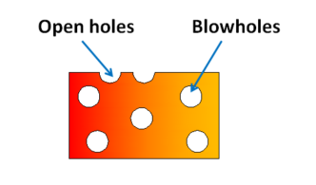
Blowholes
When gases entrapped on the surface of the casting due to solidifying metal, a rounded or oval cavity is formed called as blowholes. These defects are always present in the cope part of the mold

Slide 45
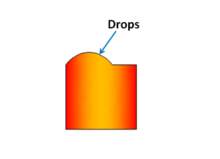
Drop
Drop defect occurs when there is cracking on the upper surface of the sand and sand pieces fall into the molten metal.

Slide 46
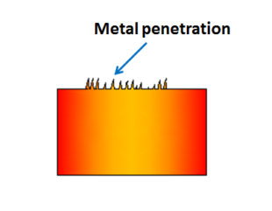
Metal Penetration
These casting defects appear as an uneven and rough surface of the casting. When the size of sand grains is larges, the molten fuses into the sand and solidifies giving us metal penetration defect.

Slide 47
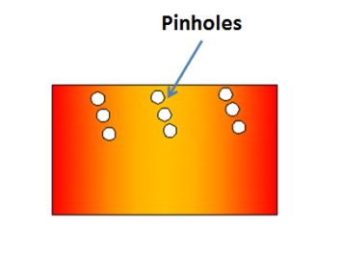
Pinholes
They are very small holes of about 2 mm in size which appears on the surface of the casting. This defect happens because of the dissolution of the hydrogen gases in the molten metal. When the molten metal is poured in the mold cavity and as it starts to solidify, the solubility of the hydrogen gas decreases and it starts escaping out the molten metal leaves behind small number of holes called as pinholes.

Slide 48
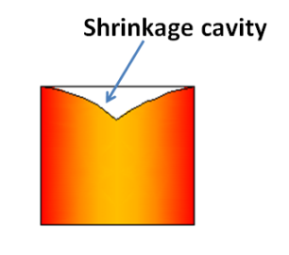
Shrinkage Cavity
The formation of cavity in the casting due to volumetric contraction is called as shrinkage cavity.

Slide 49
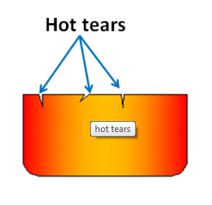
Hot Tears or Hot Cracks
when the metal is hot it is weak and the residual stress (tensile) in the material cause the casting fails as the molten metal cools down. The failure of casting in this case is looks like cracks and called as hot tears or hot cracking.

